Slide 1
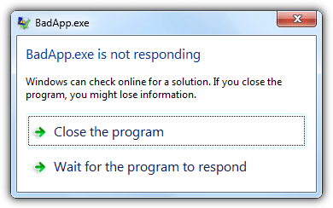
Threading and Windows Forms

Slide 2

Your turn
Solve exercise 1
and when done, jump to the advanced exercises if you want to

Slide 3
Our goals
Perform time consuming work and still have a responsive UI.
Inform the user about the state of the work in progress.
React when work is complete
Inform the user.
Do something based on the result.
Be able to cancel the work being performed.

Slide 4
Introduction / Agenda
System.ComponentModel.BackgroundWorker
Initiate a background thread from the UI.
Do some work and then the thread stops.
System.Threading.Thread
Create a thread from the main program.
The thread keeps running, until stopped by some of your code.
Update the UI with the ”Invoke” methods.

Slide 5
BackgroundWorker
The BackgroundWorker class allows you to run time-consuming operations like downloads and database transactions on a separate, dedicated thread.
Create a BackgroundWorker and listen for events that report the progress of your operation and signal when your operation is finished.
You can create the BackgroundWorker programmatically or you can drag it onto your form.
Adapted from: https://docs.microsoft.com/en-us/dotnet/api/system.componentmodel.backgroundworker?view=netframework-4.7
Notes:
The BackgroundWorker seems to fit our goals.

Slide 6
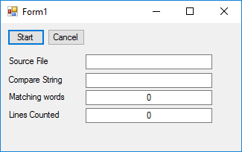
The word counter
https://docs.microsoft.com/en-us/dotnet/csharp/programming-guide/concepts/threading/walkthrough-multithreading-with-the-backgroundworker-component

Slide 7
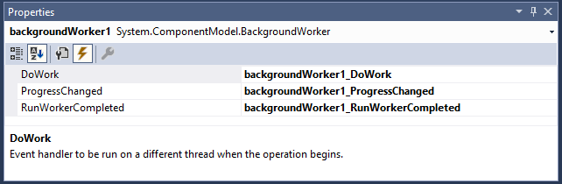
Creating a BackgroundWorker
You can create the BackgroundWorker programmatically or drag it onto your form from the Components tab of the Toolbox. If you create it in the Windows Forms Designer, it will appear in the Component Tray, and its properties will be displayed in the Properties window.

Slide 8
Run time-consuming operations on a separate thread
private void backgroundWorker1_DoWork(object sender, DoWorkEventArgs e)
{
// This event handler is where the actual work is done.
// This method runs on the background thread.
// Get the BackgroundWorker object that raised this event.
System.ComponentModel.BackgroundWorker worker;
worker = (System.ComponentModel.BackgroundWorker)sender;
// Get the Words object and call the main method.
Words WC = (Words)e.Argument;
WC.CountWords(worker, e);
}
To set up for a background operation, add an event handler for the DoWork event.
Call your time-consuming operation in this event handler.

Slide 9
Run time-consuming operations on a separate thread
private void StartThread()
{
// This method runs on the main thread.
this.WordsCounted.Text = "0";
// Initialize the object that the background worker calls.
Words WC = new Words();
WC.CompareString = this.CompareString.Text;
WC.SourceFile = this.SourceFile.Text;
// Start the asynchronous operation.
backgroundWorker1.RunWorkerAsync(WC);
}
To start the operation, call RunWorkerAsync.

Slide 10
private void backgroundWorker1_DoWork(object sender, DoWorkEventArgs e)
{
// This event handler is where the actual work is done.
// This method runs on the background thread.
// Get the BackgroundWorker object that raised this event.
System.ComponentModel.BackgroundWorker worker;
worker = (System.ComponentModel.BackgroundWorker)sender;
// Get the Words object and call the main method.
Words WC = (Words)e.Argument;
WC.CountWords(worker, e);
}
Set as the DoWork event handler on the background worker.
Called on a background thread at some point in time.
Argument to the DoWork event handler.
private void StartThread()
{
// This method runs on the main thread.
this.WordsCounted.Text = "0";
// Initialize the object that the background worker calls.
Words WC = new Words();
WC.CompareString = this.CompareString.Text;
WC.SourceFile = this.SourceFile.Text;
// Start the asynchronous operation.
backgroundWorker1.RunWorkerAsync(WC);
}
Called when the Start button is clicked.

Slide 11
Reporting progress
// Object to store the current state, for passing to the caller.
public class CurrentState
{
public int LinesCounted;
public int WordsMatched;
}
public void CountWords(
System.ComponentModel.BackgroundWorker worker,
System.ComponentModel.DoWorkEventArgs e)
{
// do some work
...
CurrentState state = new CurrentState();
state.LinesCounted = LinesCounted;
state.WordsMatched = WordCount;
worker.ReportProgress(0, state);
// do some more work
...
}
ReportProgress
takes a percentage complete and a custom object as arguments.

Slide 12
Listen for progress reports
private void backgroundWorker1_ProgressChanged(object sender, ProgressChangedEventArgs e)
{
// This method runs on the main thread.
Words.CurrentState state =
(Words.CurrentState)e.UserState;
this.LinesCounted.Text = state.LinesCounted.ToString();
this.WordsCounted.Text = state.WordsMatched.ToString();
}
To receive notifications of progress updates, handle the ProgressChanged event.

Slide 13
Listen for events that signal when your operation is finished
private void backgroundWorker1_RunWorkerCompleted(object sender,
RunWorkerCompletedEventArgs e)
{
// This event handler is called when the background thread finishes.
// This method runs on the main thread.
if (e.Error != null)
MessageBox.Show("Error: " + e.Error.Message);
else if (e.Cancelled)
MessageBox.Show("Word counting canceled.");
else
MessageBox.Show("Finished counting words.");
}
To receive a notification when the operation is completed, handle the RunWorkerCompleted event.

Slide 14
Cancel the operation
private void Cancel_Click(object sender, EventArgs e)
{
// Cancel the asynchronous operation.
this.backgroundWorker1.CancelAsync();
}
The RunWorkerCompleted event handler will be called after cancellation.
Called when the Cancel button is clicked.

Slide 15
Your turn
Solve exercise 2

Slide 16
Your turn
Solve exercise 3, 4, 5 and 6
and when done jump to the advanced exercises if you want to

Slide 17
References and image sources
Images:
BadApp not responding: https://www.raymond.cc/blog/forcefully-close-full-screen-application-or-game-with-superf4/
Computer keyboard: http://stockmedia.cc/computing_technology/slides/DSD_8790.jpg

